Slide 1
The Proxy Pattern
Simple, yet complicated

Slide 2
The Proxy Pattern
First, what is a proxy?
A: noun: A person authorized to act on behalf of another.
Now use the OO concept, abstraction.
What is a proxy in terms of OO programming?
A: A local object that works in place of a remote instance.
Further:
A proxy is acted on by our local application, and passes that request to the remote instance

Slide 3

The Proxy Pattern
Pattern defined:
The Proxy Pattern provides a surrogate or placeholder for another object to control access to it
Use the Proxy Pattern to create a representative object that controls access to another object, which may be remote, expensive to create, or in need of securing

Slide 4
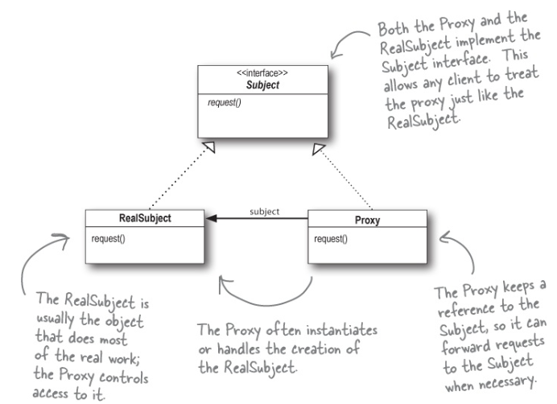
The Proxy Pattern

Slide 5
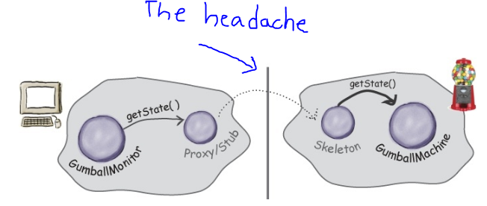
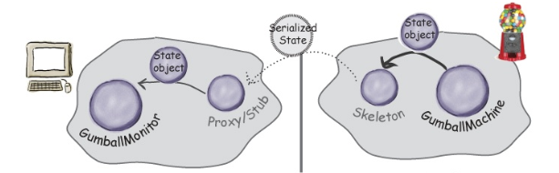
The Proxy Pattern
So why does the title page say this is complicate?
Clearly you just have a proxy class that carries an instance of concrete class
The proxy then call the concrete class to do some work.
What’s the big deal?
Notes:
Note: the proxy class is often called the stub. The control class on the remote end that receives the proxy’s request is called a skeleton.

Slide 6
The Proxy Pattern
Also…more than one type of proxy.
Remote Proxy:
This one is as expected…proxy is a local representative of a remote instance
Virtual Proxy:
This one is used when an object is expensive to create
Defers object instantiation until it is needed
Works as a surrogate before and while that expensive object is being created
Delegates requests to the real object aftewards

Slide 7
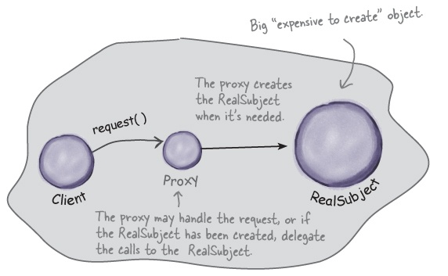
The Proxy Pattern
Virtual Proxy:

Slide 8
The Proxy Pattern
Virtual proxy.
Full disclosure, I haven’t used one.
Probably relevant for large media files that need to load
Proxy could stand-in and display a loading message or similar
Once media is ready, proxy delivers it, and then acts as a pass-thru for future requests.
Thought: may not be as relevant in the era of ultra-fast internets/broadband speeds

Slide 9
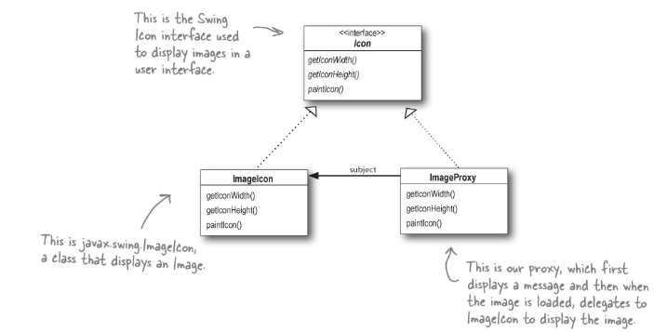
The Proxy Pattern

Slide 10
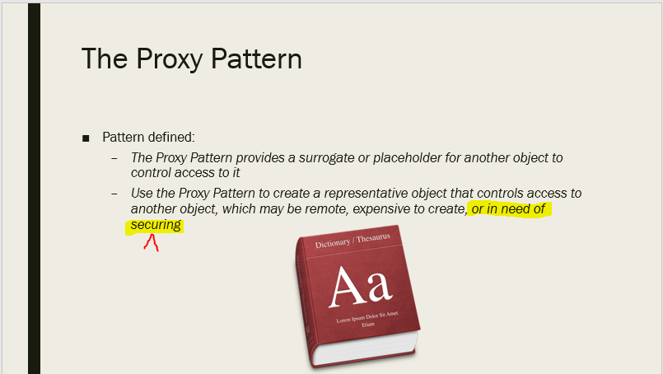
The Proxy Pattern
But wait…There’s more!
The proxy pattern can also be used to protect!

Slide 11
The Proxy Pattern
Protection proxy
Allows user access level differences
Think employee records
Employees and managers have access to different data
Why? We could just put conditions in the employee class
Encapsulate what varies/Single responsibility
Employee would then be responsible for its security as well as employee data/functions

Slide 12
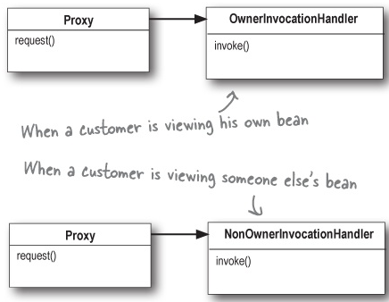
The Proxy Pattern
Protection proxy
Usually involves multiple proxy classes
Different proxies with access to methods are presented based on need

Slide 13
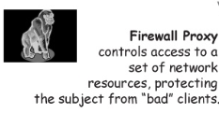
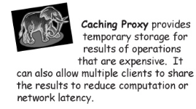
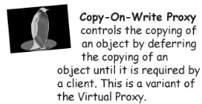
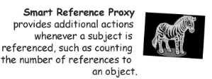
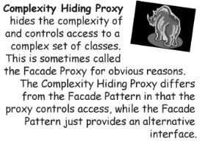
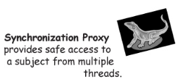
The Proxy Pattern
But wait…there’s still more!

Slide 14

The Proxy Pattern
Note: Critical failing of the book.
Requires use of the JAVA RMI libraries.
Requires use of JAVA Swift classes
Requires use of built-in JAVA proxy tools
Really, it requires that we’re working in JAVA, and the early part of the chapter even references the Head First JAVA book.

